Slide 1


Human Activity Recognition from Videos
Gopikrishna Erabati and Mohit Ahuja
MsCV
University of Burgundy

Slide 2
Problem Statement and Applications
Recognize the actions performed in video
Input : Video
Output : Action
Applications:
Video surveillance
Video content analysis and search
Intelligent human computer interactions
Medical applications

Slide 3
Introduction
Extraction of appropriate features
Actions are characterized by 3 dimensional features
Challenges
Viewpoint variation
Speed variation
Performing style variation
Cluttered & moving backgrounds
Earlier : Segmentation
Feature tracking fails when appearance changes
Now : Interest point based feature
Notes:
Local image features or intrest points provide compact and abstract representations of patterns in an image.

Slide 4
Introduction contd…
Interest Points
Compact & abstract representation of patterns in an image
KTH Dataset
Six actions
Boxing, hand clapping, hand waving, jogging, running, walking

Slide 5
Methodology
Spatio-temporal Interest Points (STIP) + HOG
Optical Flow + HOF
3D SIFT

Slide 6

Spatio-Temporal Interest Points (STIP)
Corner Map
Binarization
Derivative of Image
Finding angle $θ, Bin$
HOG
Repeat
SVM
Test

Slide 7

Spatio-Temporal Interest Points (STIP)
Step 1:
2D Harris Corner Detector
Detect positive maxima of the corner function:
* SP = Spacial Image
Notes:
Local image features or intrest points provide compact and abstract representations of patterns in an image.

Slide 8
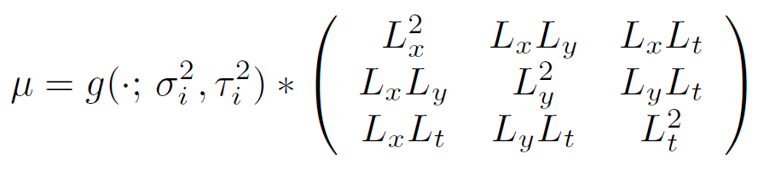
Spatio-Temporal Interest Points (STIP)
3D Harris Corner Detector
Detect positive maxima of the corner function:
Notes:
spatio-temporal interest points of f can be found by detecting local positive spatio-temporal maxima in H.

Slide 9
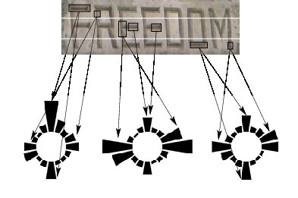
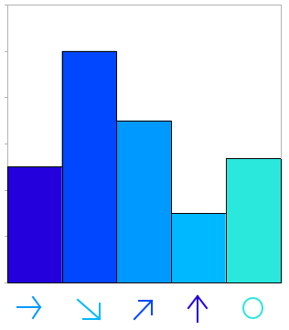

Spatio-Temporal Interest Points (STIP)
Corner Map – Done
Derivative of Image
Find Angle $θ$
$θ= \tan^{−1}$($\frac{Y}{X}$)
Y - Derivative w.r.t y
X - Derivative w.r.t x
Example – 9 Bins

Slide 10
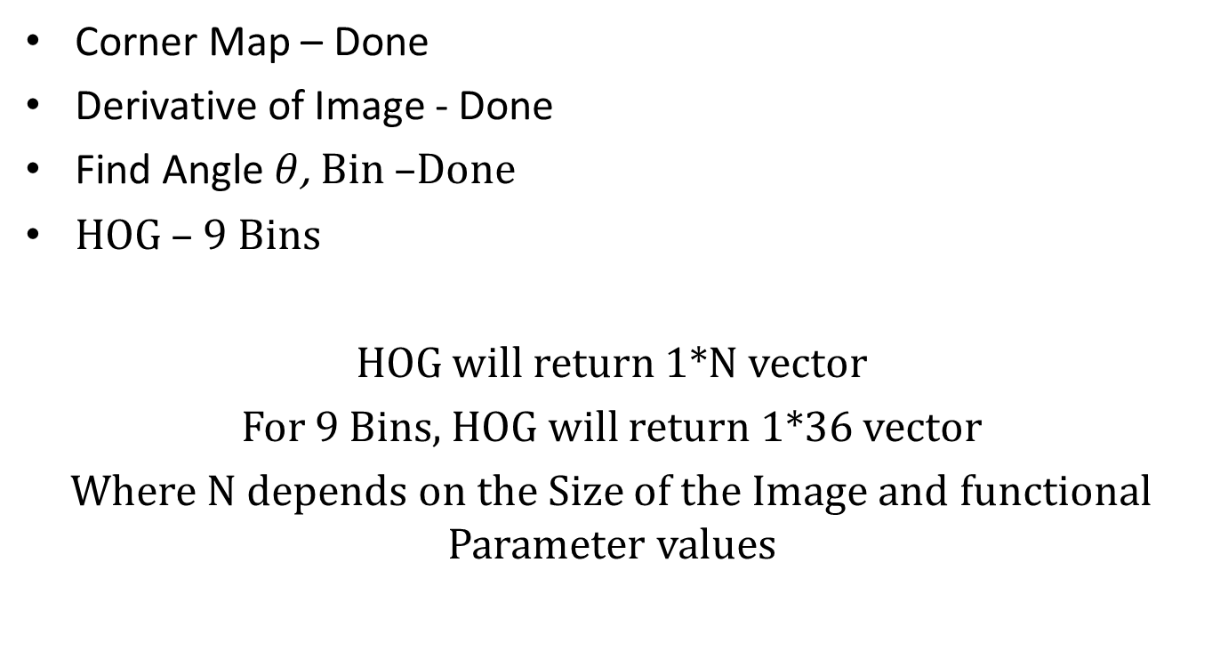
Spatio-Temporal Interest Points (STIP)
Corner Map – Done
Derivative of Image - Done
Find Angle $θ$, Bin –Done
HOG – 9 Bins
HOG will return 1*N vector
For 9 Bins, HOG will return 1*36 vector
Where N depends on the Size of the Image and functional Parameter values

Slide 11


Spatio-Temporal Interest Points (STIP)
Corner Map – Done
Derivative of Image - Done
Find Angle $θ$, Bin –Done
HOG – Done
Repeat it with all Images
Repeat it with all Videos
Train With SVM
Test

Slide 12
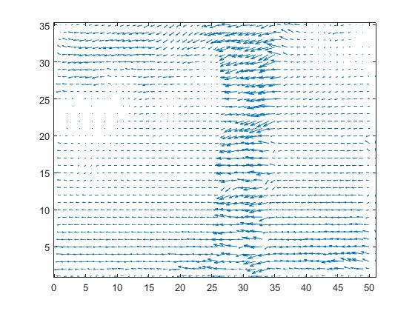
Optical Flow + HOF
Optical Flow?
Apparent 2D image motion of pixels

Slide 13


Optical Flow + HOF contd…
Brightness Constancy Assumption
OF constraint equation
Lucas Kanade (local method)
Idea : OF is constant on neighborhood of current point

Slide 14
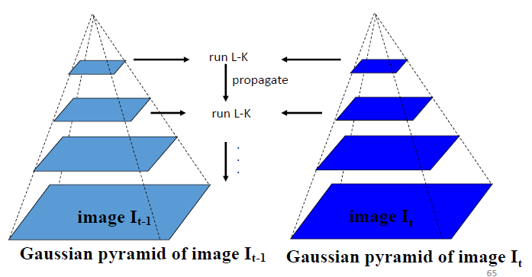
Optical Flow + HOF contd…
For large motion ?
Multi resolution Lucas kanade

Slide 15
Optical Flow + HOF contd…
Why not raw OF directly?
# of pixels in person (descriptor) changes
susceptible to background noise, scale, directionality
Distribution of OF
Histogram of oriented OF (HOOF)
binned : primary angle with horizontal
weighted : magnitude

Slide 16

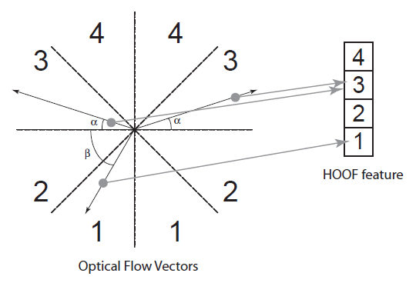
Optical Flow + HOF contd…
θ in range, contribute to bin ‘b’ by sqrt(x²+y²)
Histogram normalized – scale invariant

Slide 17
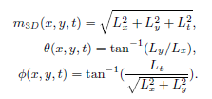
3D SIFT
3D Sift descriptor – info. local in space and time
Interest points
local maxima to Gabor response function
Descriptor
vec. gradient of 3D neighborhood
sub histograms to encode local time and space

Slide 18
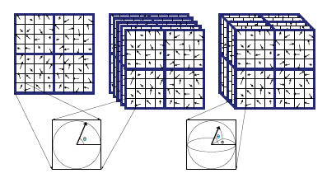
3D SIFT contd…
3D descriptor
sub histogram : sub region around interest points
3D sub region : accumulate orientation to a histogram

Slide 19
3D SIFT contd…
Quantization of descriptors – Bag of Words
K – means clustering
cluster center : word
collection of cluster center: Spatio temporal word vocabulary
descriptor matched with each word and frequency of words in each video accumulated to histogram
word frequency histogram is called Signature

Slide 20
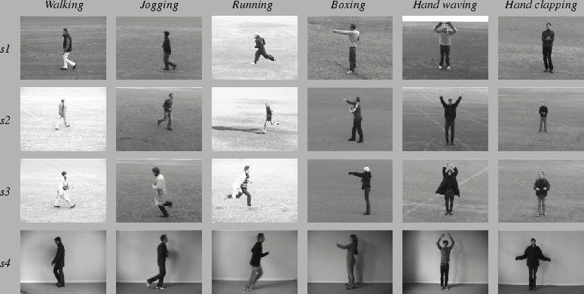
KTH Dataset

Slide 21
Results
STIP + HOG
train : 126 videos
test : 54 videos
Accuracy achieved : 48%
Confusion Matrix
 | Boxing | Hand clapping | Hand waving | Jogging | Running | Walking
Boxing | 56 % | 22 % | 11 % |  | 11 %
Hand Clapping |  | 56 % | 33 % |  | 11 %
Hand Waving | 11 % | 22 % | 67 %
Jogging | 22 % | 11 % | 11 % | 12 % | 33 % | 11 %
Running |  |  | 11 % |  | 89%
Walking |  | 11 % | 33 % | 11 % | 33 % | 12 %

Slide 22
Results
OF + HOOF
train : 126 videos
test : 54 videos
Accuracy achieved : 60%
Confusion Matrix
 | Boxing | Hand clapping | Hand waving | Jogging | Running | Walking
Boxing | 50 % | 9 % | 30 % |  |  | 10 %
Hand Clapping | 30 % | 29 % | 30 % |  |  | 11 %
Hand Waving | 50 % |  | 50 %
Jogging | 8 % | 8 % | 84 %
Running | 8 % | 10 % |  |  | 62 % | 10 %
Walking | 8 % | 8% |  |  |  | 84 %

Slide 23
Results
3D SIFT
train : 54 videos
test : 30 videos
Accuracy achieved : 40%
Confusion Matrix
 | Boxing | Hand clapping | Hand waving | Jogging | Running | Walking
Boxing | 60 % |  | 20 % | 20 %
Hand Clapping |  |  | 80 % |  |  | 20 %
Hand Waving |  | 20 % | 40 % | 40%
Jogging |  |  |  | 40 % | 20 % | 40 %
Running |  |  |  |  | 80 % | 20%
Walking |  |  |  | 40 % |  | 60 %

Slide 24
Conclusion
Feature selection is crucial
In our experimentation, SIFT takes lot of time.
Parallel computing
Optical Flow gave us better accuracy among three methods.
SIFT accuracy can be improved if we consider more frames and more descriptor length of each video, but there will be some tradeoff.

Slide 25
Thank You

